Slide 1

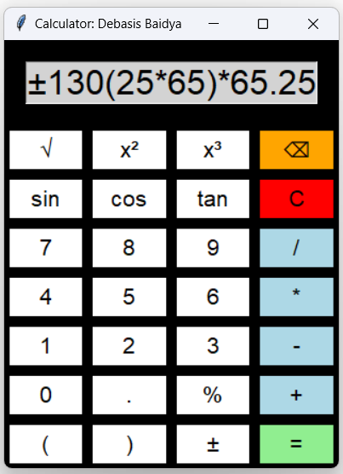

GUI Calculator Project Overview
This presentation will walk through a GUI Calculator Project built using Python and Tkinter, highlighting its key features, code structure, and functionality to demonstrate how the calculator works.
The project utilizes the Math module to extend its capabilities beyond basic arithmetic, allowing for operations like square roots and trigonometric functions. Additionally, the Messagebox library plays a crucial role in error handling and user feedback, alerting users when they attempt to divide by zero or enter invalid expressions, thus ensuring a smooth user experience.
Overall, this project combines these elements to create a powerful and user-friendly calculator application.
by Debasis Baidya

Slide 2



Project Structure
The project is structured around a Tkinter main window, with an entry widget for input and buttons that trigger calculations through the on_button_click function.
01
02
03
Tkinter Framework:
Core Functionality:
on_button_click(ch)
Math Operations:
Tkinter is used to build the GUI of the calculator, handling the layout and user interactions.
This function updates the display based on user input, performs calculations, and shows results or errors.
Includes basic operations and functions like sin, cos, tan, square root, square, and cube, all using Python’s math module.
Notes:
© Copyright PresentationGO.com – The free PowerPoint and Google Slides template library

Slide 3



User Interface Design
02
01
03
Customization
Tkinter GUI
Button colors and sizes are customized for a better user experience.
Functionality
The interface uses a grid layout with buttons for operations and digits
The calculator supports standard operations, square roots, and trigonometric functions.
Notes:
© Copyright PresentationGO.com – The free PowerPoint and Google Slides template library

Slide 4

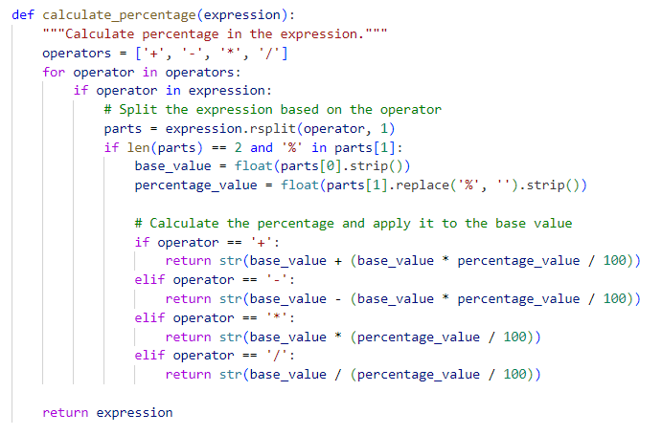
Percentage Calculation
1
Expression Parsing
The calculate_percentage function splits the expression based on operators and identifies percentage values.
2
Percentage Computation
The function applies the percentage to the base value to compute the final result.
3
Handling Percentages
This allows the calculator to accurately process expressions like GST Calculation "100 + 18% = 118” & Discount Calculation “100-15% = 85”.

Slide 5

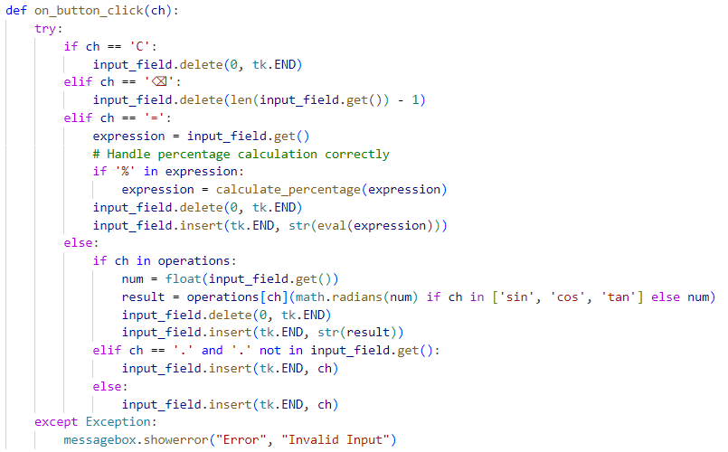
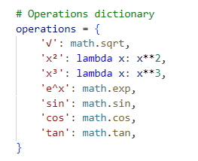
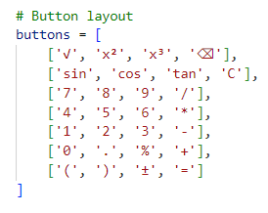
Handling User Input
1
on_button_click Function
2
Operations Dictionary
3
Error Handling & Button Layout
Manages all user inputs, from clearing the display to computing results.
Backspace & Clear Buttons work to handle typos.
Advanced operations are mapped in a dictionary for easy reference and execution.
Invalid inputs trigger an error message.
Button Layout positions buttons in the Calculator.

Slide 6



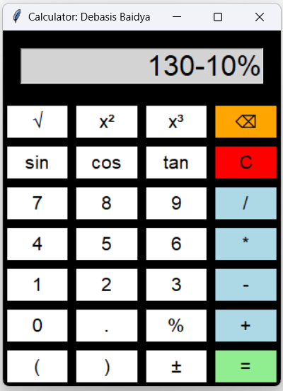


Key Features
Advanced Mathematical Operations:
Perform complex calculations with ease, including trigonometric functions
(sin, cos, tan), Root (√), Square (x)² & Cube (x³).
Percentage Calculations:
Effortlessly calculate percentages with the dedicated '%' button, supporting
addition, subtraction, multiplication, and division operations.
Intuitive User Interface:
- Black background and colorful buttons
- Clear typography
- Organized button layout
- Resizable design
Comprehensive Functionality:
- Basic arithmetic ( +, -, *, / )
- Parentheses and negation ( ), ( ± )
- Decimal input ( . )
- Dedicated buttons for common operations

Slide 7




Conclusion
Efficient Calculations
The calculator handles a variety of mathematical operations.
User-Friendly Design
The customized Tkinter interface provides a smooth user experience.
Robust Performance
The app is designed to be reliable and handle user errors.

Slide 8





Conclusion and Future Improvements
Summary
Future Enhancements
Q&A
The key points of the calculator project were discussed.
Potential improvements include adding more advanced functions and refining the UI.
The presentation is open for any questions & suggestions from the reviewer.

